Slide 2
Gap between Accessibility and Disability in GB
Accessibility: accessible rail stations / total rail stations
Disability: disabled population in local authority
Aim: analyse whether the construction of the accessible facilities in train stations match the distribution of the disabled population.
How to use this html page?
What can this html page tell users?

Slide 3
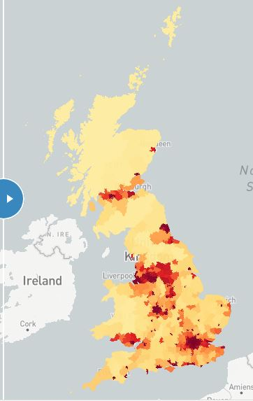
Overall situation -- based on disabled population density
Disabled population / Area of local authority
Major economic cities have greater density

Slide 4
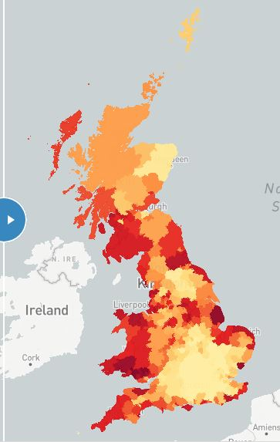
Overall situation -- based on disabled population proportion
Disabled population / Total population of local authority
Coastal cities have larger proportion

Slide 5
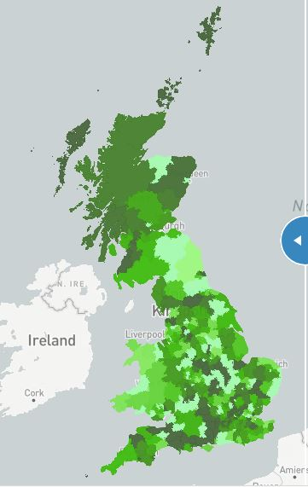
Overall comparison -- based on disabled population proportion
Disabled population / Total population of local authority
Coastal cities have larger proportion
More in line with the accessible station proportion
Reflects the proportion of demand

Slide 6
Overall comparison -- based on disabled population density
Disabled population / Area of local authority
Major economic cities have greater density
Less consistent with the accessible station proportion
Why? -- more specific analysis

Slide 7
Comparison in specific region or city
Greater London
- disabled population density is completely different from the proportion
Liverpool & Knowsley
- disabled population density and proportion are both relatively high
- are adjacent to each other with similar areas and situations
Summary: small gap between accessibility and disability, but they are generally matched.

